Slide 1
Java Advance
SAMAR MANSOUR

Slide 2
Concept
Servlet config
Servlet context
Get and post
Deployment and descriptor
Session management

Slide 3
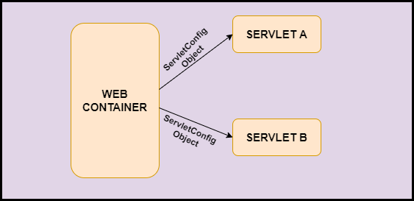
Servlet config

Slide 4
Web.xml
<servlet>
<servlet-name>abc</servlet-name>
<servlet-class>ServletRequestDemo</servlet-class>
</servlet>
<servlet-mapping>
<servlet-name>abc</servlet-name>
<url-pattern>/abc</url-pattern>
</servlet-mapping>

Slide 5
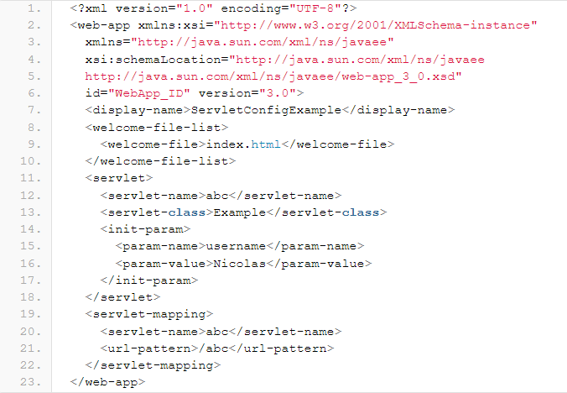

Slide 6
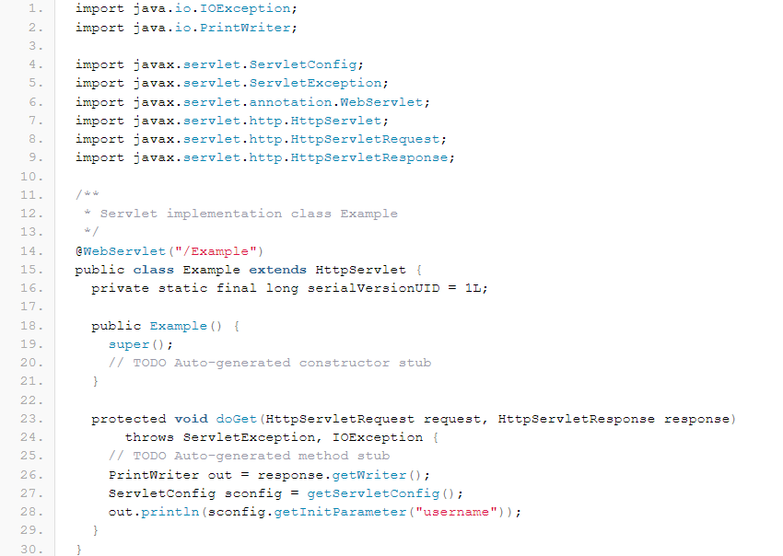

Slide 7
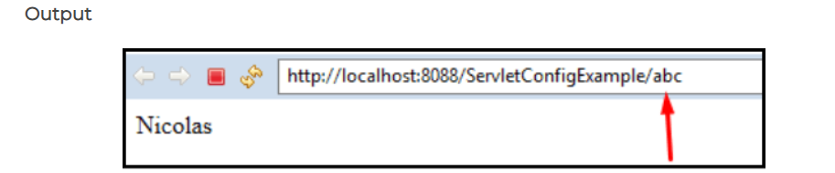

Slide 8
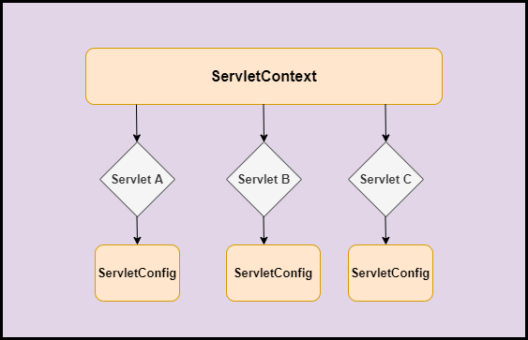
Servlet context

Slide 9
Advantages of ServletContext
If any information is changed in web.xml then the changes will be available to all the servlet.
It can be used to get configuration information from web.xml.
It can be used to get, set attribute.
In order to communicate between web containers and servlet ServletContext is used.

Slide 10
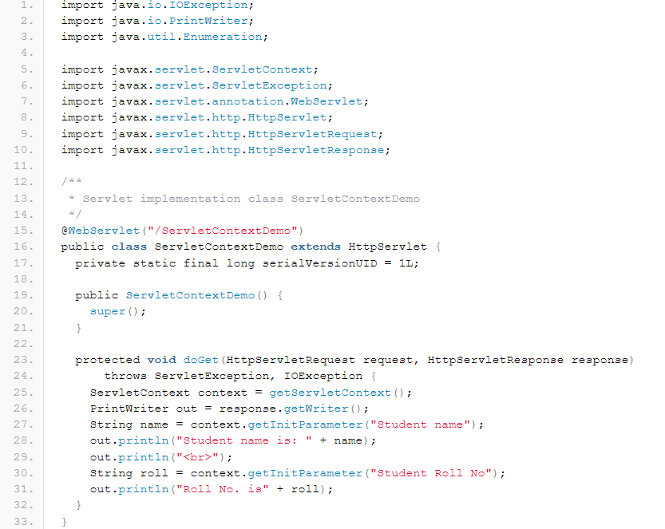

Slide 11
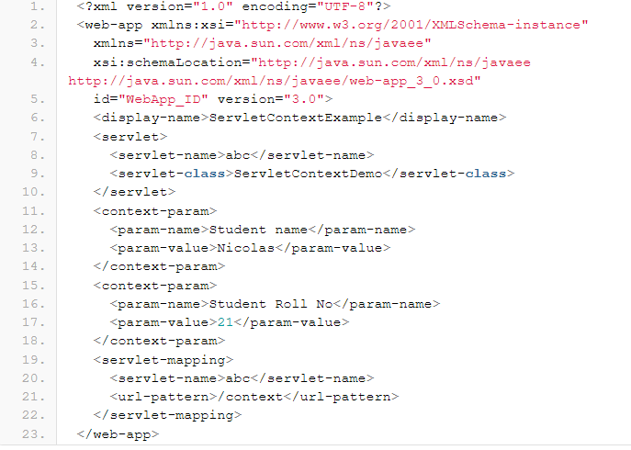

Slide 12
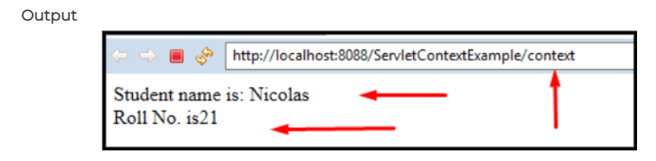

Slide 13
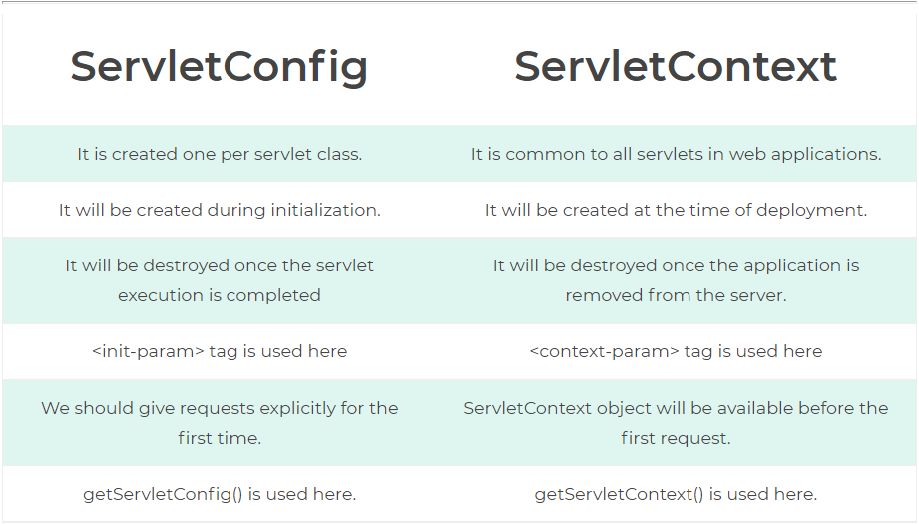

Slide 14
Get and post
What is GET in Servlet?
The GET method is the method used by the client to ask the server to send back a given resource.
The GET is a method that sends the information appended to the user request.
In the following example, we see the information like key1 & key2 is passed along with the request.
The data is appended to the URL as a series of name/value pairs.
The GET method is a default method.
The GET method is used to retrieve data from the browser. The servlet handles this type of request in the doGet() method.

Slide 15
Get and post
What is Post in Servlet?
The POST method is the method the browser uses to talk to the server when asking for a response.
The POST is a method that sends the information from browser to server and is more reliable as compared to GET.
In the following example, the information passed is the same as that of getting the method only difference here is that instead of sending string after? it sends as a separate message.
The servlet handles this type of request in the doPOST() method.
When we submit the form with the POST method, we get no data appended to the URL.

Slide 16
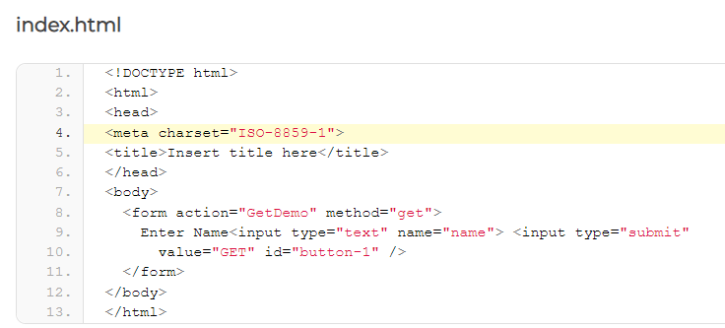

Slide 17
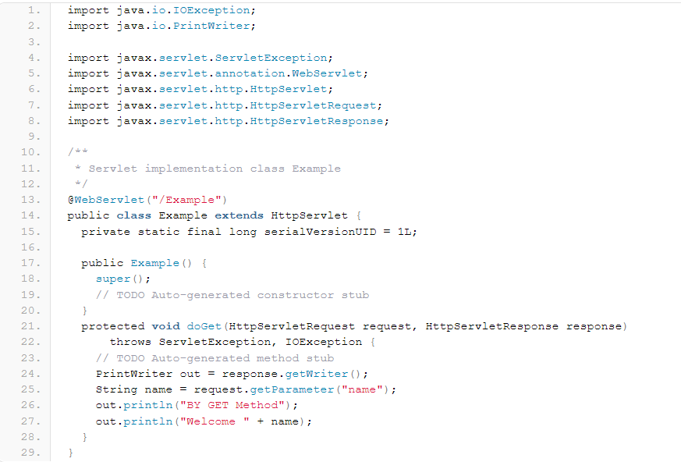

Slide 18
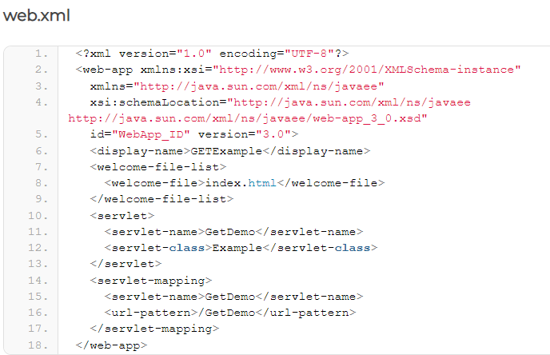

Slide 19
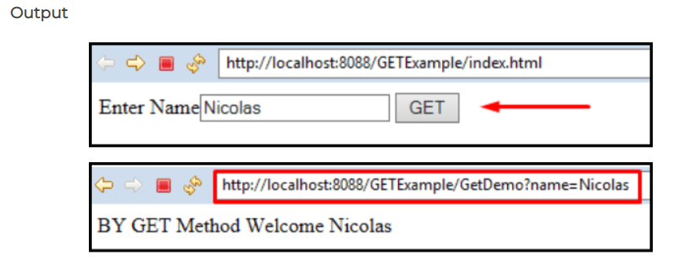

Slide 20
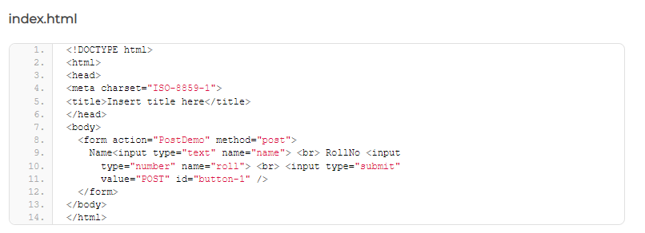

Slide 21
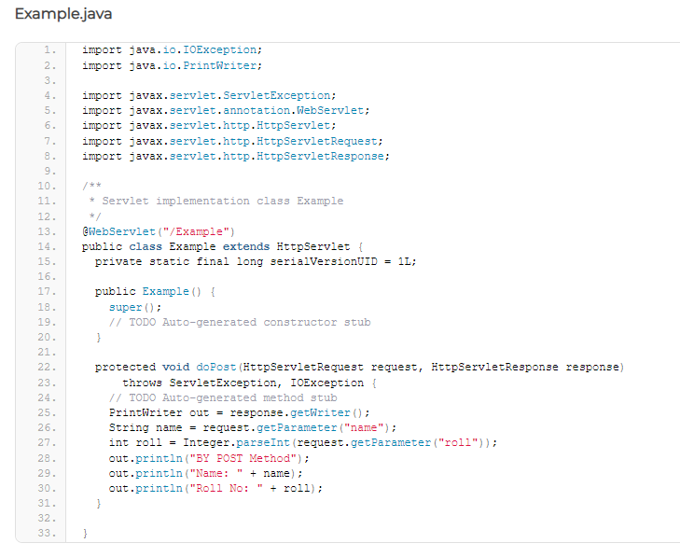

Slide 22
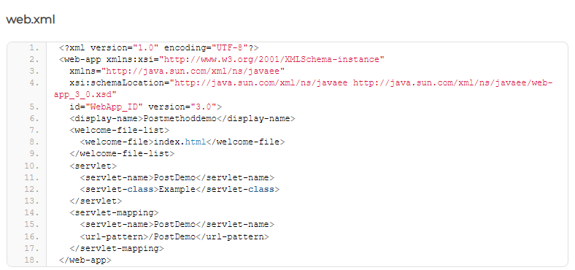

Slide 23
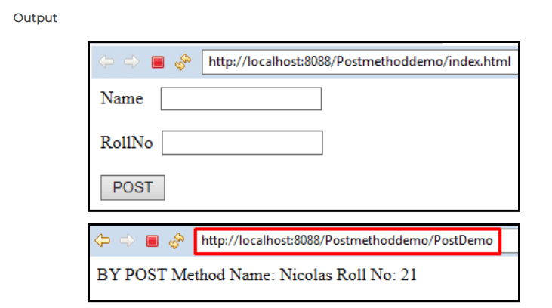

Slide 24
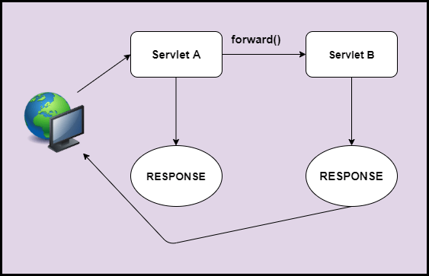
Deployment and descriptor

Slide 25
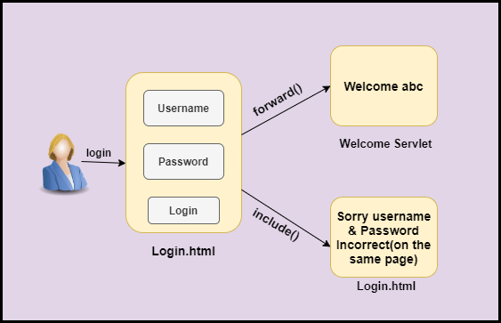
Example of RequestDispatcher Interface in servlet

Slide 26
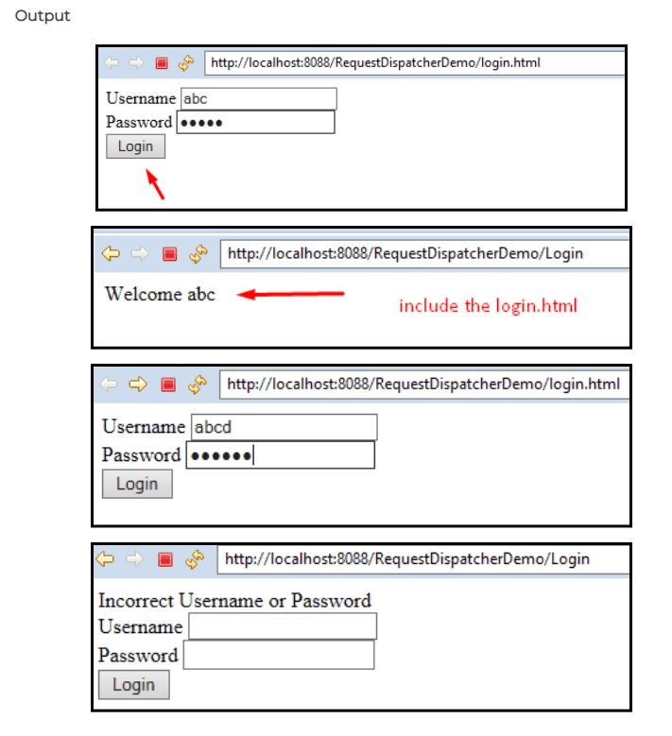

Slide 27
Session management
Servlet provides the HttpSession Interface which provides a way to identify a user across more than one page. Session means a particular interval of time. Session Tracking is used to keep the state of the user across pages. The following are the methods we used for session tracking.

Slide 28
Session management
Cookies in servlet
One way we have seen earlier is Cookies. A webserver assign uniques session Id to each request. But the cookie is not recommended by many because many browsers don’t support cookies.
Hidden Form Fields
Another way is Hidden Form Fields In this a webserver can send hidden HTML form filed with session Id. But this is not a good way because <a href > tag does not result in form submission.so this method does not support session Tracking.

Slide 29
Session management
URL Rewriting
One more way is URL Rewriting. In this extra data is appended at the end of the URL that identifies the session. It is a better method as compared to both Cookies and Hidden form fields. The drawback here is we have to generate a URL dynamically to assign a session ID.
Http session Object
Servlet provides us an interface of Httpsession for session tracking. In this, the Servlet container creates a separate session-id for the users which helps in identifying a user in the system. (like we have unique Roll no in school).We get the object by calling method getSession() of HttpServletRequest.

Slide 30
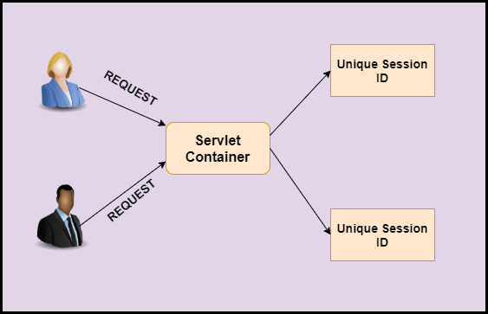

Slide 31
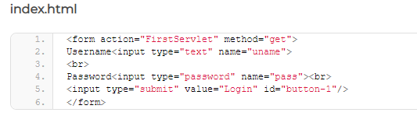
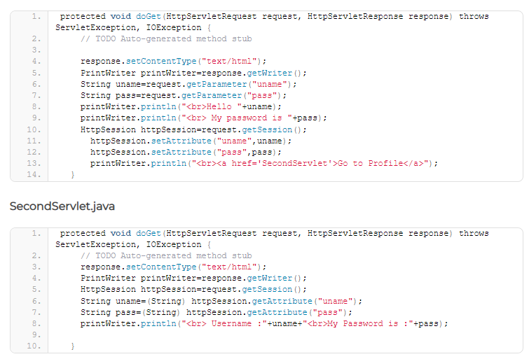

Slide 32
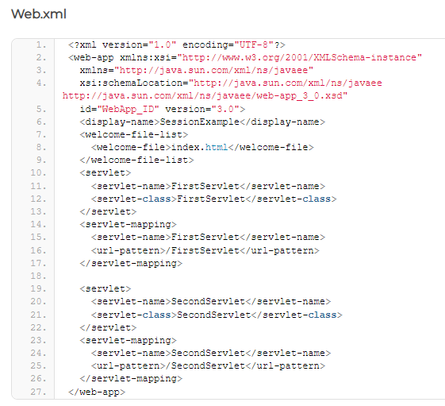

Slide 33
